Slide 1
DATABASE DESIGN By: Group 3
Module 03
Full Stack Web Development

Slide 2
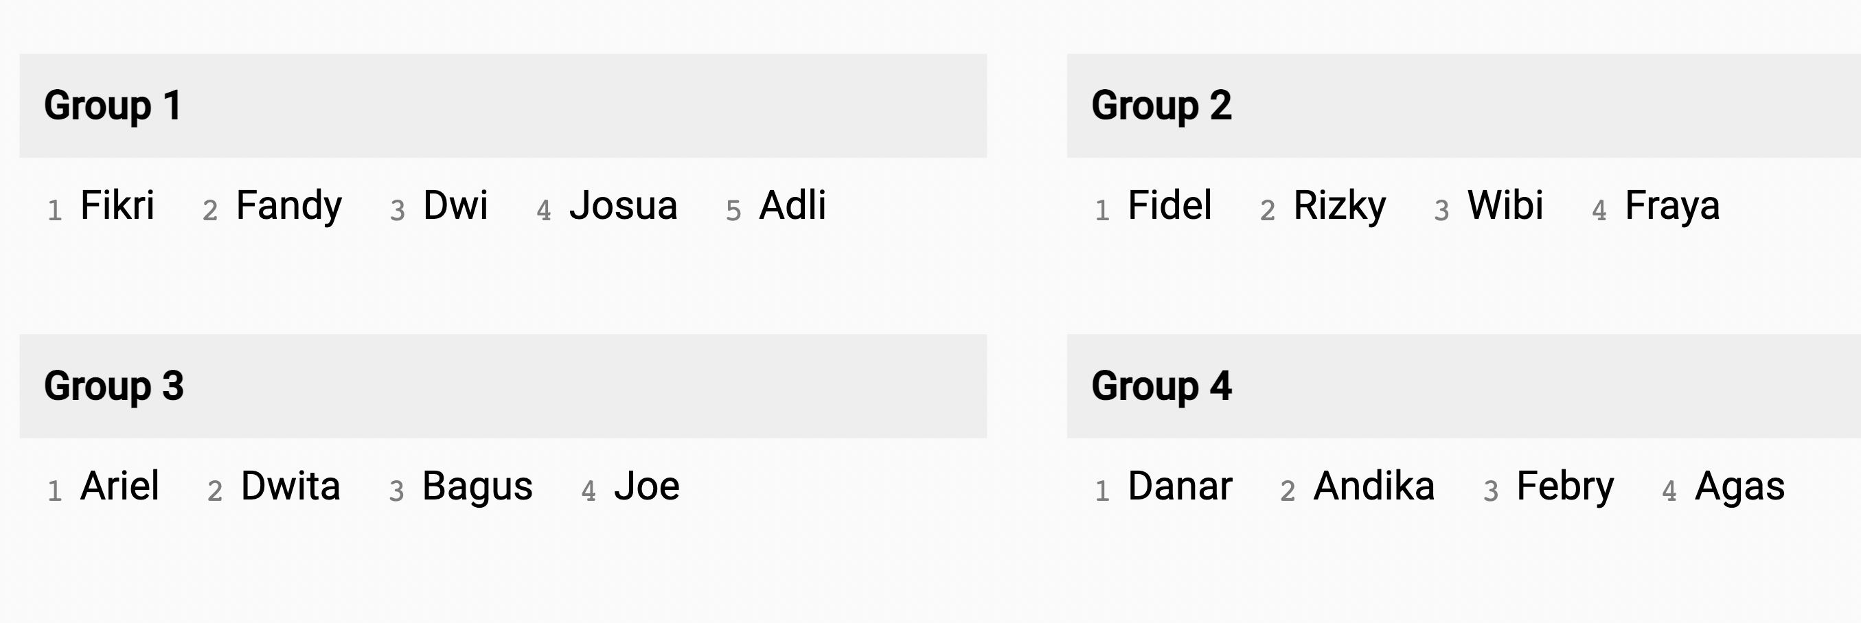
Group 3
Ariel
Bagus
Dwita
Joel

Slide 3
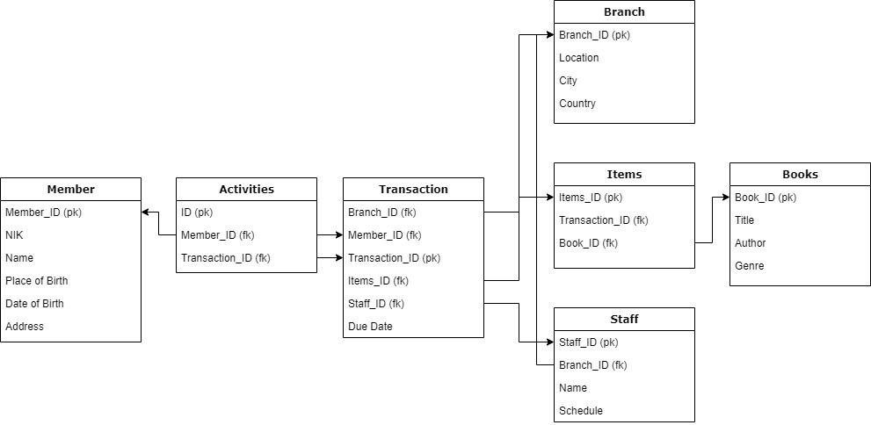
Database Design Schema

Slide 4
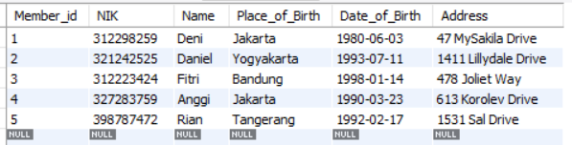
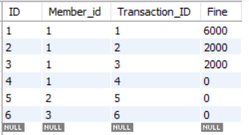
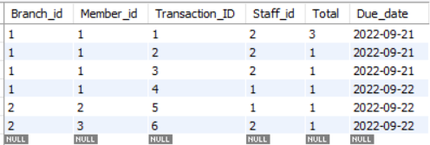
Data Table Detail
Member:
Activities:
Transaction:

Slide 5

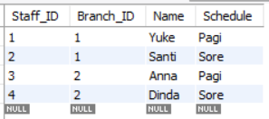
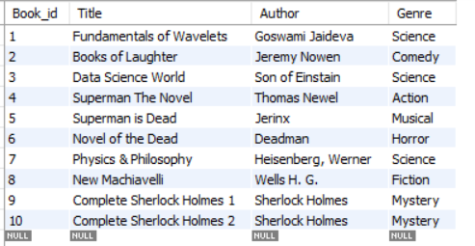
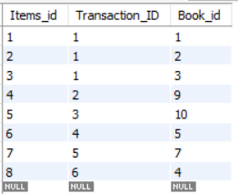
Data Table Detail
Branch:
Staff:
Books:
Items:

Slide 6
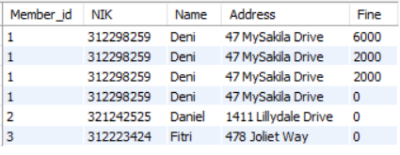
Random Query Check
Member’s Fine:
Assume Rp. 2.000 for each day from due date
Output =>

Slide 7

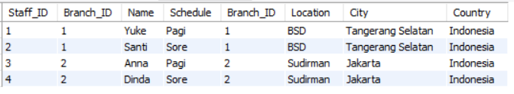
Random Query Check
Locating staff working area:
Output =>

Slide 8
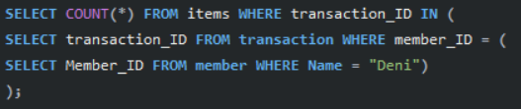

Random Query Check
Find out how many book does ‘Deni’ borrowed.
Output =>

Slide 9
End of Presentation
Ariel
Bagus
Dwita
Joel
Thank you

